Slide 1
Modeling 101
Paul Kaefer, M.S.
30 October 2015
Notes:
PLEASE interrupt at any time.
Inspired by “Modeling 101” that Dr. Brown gives at GasDay, though I don’t have a copy of it, so the work here is my own.

Slide 2
What is a model?
Last week, we discussed many different types of models.
A mathematical model is simply a way to describe a system using math and words.
Remember, the model is not the system. But it tries to imitate the system.
Notes:
The model is always wrong. But some models are better than others.

Slide 3
What types of models have you seen?
Take two minutes each.
Talk about one type of model.
Where have you seen it?
What do you know about it?
What is confusing about it?
Notes:
Me: log-link function. Mentioned in Human-Baited Double Net Trap paper.
I have learned it in my Econometrics course, as “logit” model
Basically, it’s a way of finding probability. You use what are called logarithms, because they can help you make sure everything becomes 0 → 1
I went back to the paper, and still don’t understand where they used it, or why they felt they needed it.
When I learned about it in class, we talked about things like probability of owning a house.
P(getting trapped in HDN) would be interesting, but I don’t see it in the paper.

Slide 4
What words do we use?
Data – information used to build our model. It’s never perfect; it’s always bad/dirty in some way(s).
Model – in this case, uses math to describe the data, and thus the system
Parameters – usually numbers; they represent some part of the model. Usually one per variable (mosquitoes, temperature, etc.)
Intercept – value if all your variables are set to zero (where the model crosses the y-axis)
Fit – to figure out what value each of the parameters including intercept should have
Error – how much is the model wrong?

Slide 5
Some more vocabulary
Outlier – data point that is suspicious. It may or may not be “wrong.” There are many causes, including data entry mistake or system fault.
Missing data – where something is not available. NOT THE SAME AS ZERO! Maybe someone forgot to record it, or lost a form.
Probability – always between 0 (no chance) and 1 (100% likely).
Linear regression (LR) – type of models we will use today
Notes:
100% == “completely likely” to occur

Slide 6
Let’s fit a model!

Slide 7

Our example data set

Slide 8
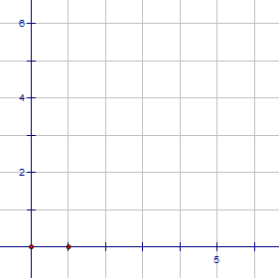
Step 1: draw your axes
30
25
Number of mosquitoes attracted
20
15
10
5
0
1
2
3
4
5
6
Units of CO₂
Notes:
Axes made using The Geometer’s Sketchpad

Slide 9
Step 2: plot your data

Slide 10
Step 2: plot your data
30
25
Number of mosquitoes attracted
20
15
10
5
0
1
2
3
4
5
6
Units of CO₂

Slide 11
Step 3: fit a line through your data
30
25
Number of mosquitoes attracted
20
15
10
5
0
1
2
3
4
5
6
Units of CO₂

Slide 12
Step 3: fit a line through your data
30
25
Number of mosquitoes attracted
20
15
What’s the slope?
What’s the intercept?
10
5
0
1
2
3
4
5
6
Units of CO₂

Slide 13
Step 4: use your model to make predictions
30
25
Number of mosquitoes attracted
20
15
y = 5 * x + 5
mbu = 5 * CO₂ + 5
10
5
0
1
2
3
4
5
6
Units of CO₂

Slide 14
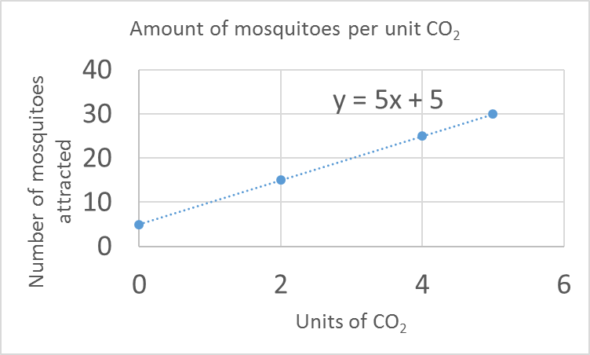
This is REALLY EASY in Microsoft Excel
Right click plotted data and say “Add trendline”
Notes:
There’s an option to “display equation on chart”
You can add other types than just linear

Slide 15
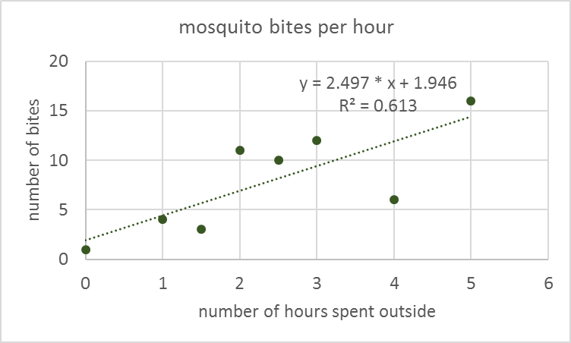
Another example
If I spend 3 hours outside, how many bites should I expect?

Slide 16
Some closing thoughts
The model is always wrong. But some models are better than others.
More information:
Wikipedia: http://en.wikipedia.org/wiki/Mathematical_model
Books: Statistics Done Wrong, Statistics Hacks, etc.
Textbooks and papers: I’m happy to talk about them

Slide 17
More next week!
Let me know in advance if there’s a specific model type you would like to discuss.

Slide 18
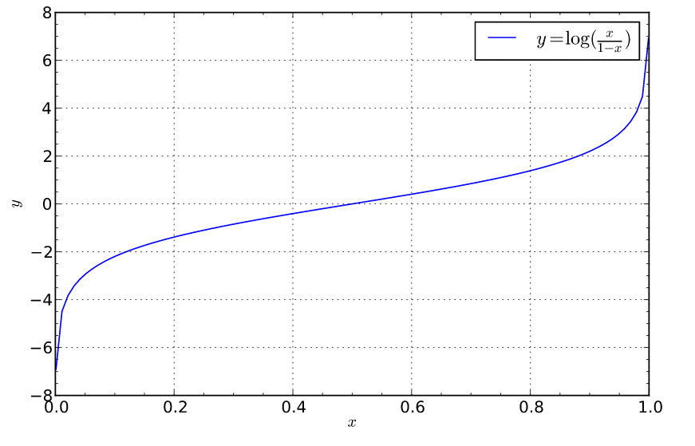
Logit
Image from https://en.wikipedia.org/wiki/Logit
This is what you want to predict
This is probability, ranging from 0 to 1

